Slide 1
Towards natural voices created from very short recordings: new developments in NN parametric TTS and voice conversion
Mr. Darko Pekar, Speech Morphing Inc.

Slide 2
Contents
Text-to-Speech development in SMI:
HMM-TTS
Hybrid TTS
Neural networks based TTS
Improvements to TTS:
Separate modelling of spectral details
Voice conversion:
Simple approach

Slide 3
Contents
Text-to-Speech development in SMI:
HMM-TTS
Hybrid TTS
Neural networks based TTS
Improvements to TTS:
Separate modelling of spectral details
Voice conversion:
Simple approach

Slide 4
Contents
Text-to-Speech development in SMI:
HMM-TTS
Hybrid TTS
Neural networks based TTS
Improvements to TTS:
Separate modelling of spectral details
Voice conversion:
Simple approach

Slide 5
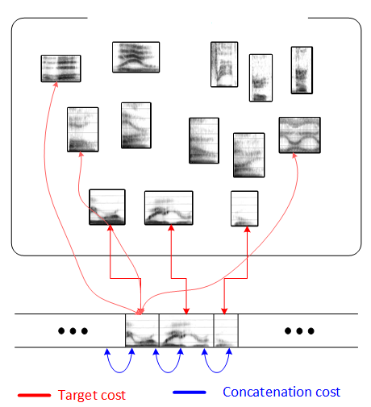
Hybrid TTS
Combine unit slection and HMM:
Train HMM-TTS
Parametrize the whole database
Perform state-level alignment of the database
Generate initial parameters by using HMM
Search for optimal (real) segments (arrays of states) in the database
Search is based on both target and concatenation costs
Collect parameters of selected segments
Synthesize speech
Motives:
Approach has potential of reaching high quality
Remains flexible, since it’s parametric
All units (states) in the database

Slide 6
Contents
Text-to-Speech development in SMI:
HMM-TTS
Hybrid TTS
Neural networks based TTS
Improvements to TTS:
Separate modelling of spectral details
Voice conversion:
Simple approach

Slide 7
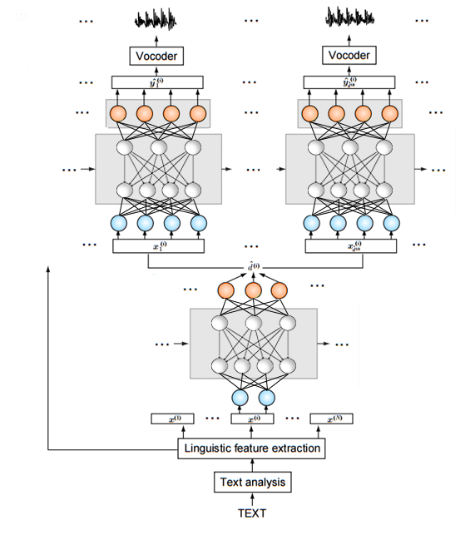
Neural networks based TTS
Used architecture:
Text analysis produces phonetic content and prosodic context
563 lingusitic features (LF) are extracted based on that
LFs are input to NN which predicts state durations
Acoustic NN predicts MGCs, f0 and aperiodicity, per frame, based on LFs and state durations
Optional MLPG and post-filtering are applied
Acoustic parameters are fed to vocoder (WORLD)
Waveform
Acoustic features
Acoustic NN
Frame-level liguistic features
State durations
Duration NN
Phoneme-level liguistic features

Slide 8
Comparison
HMM
Hybrid
Neural networks

Slide 9
Contents
Text-to-Speech development in SMI:
HMM-TTS
Hybrid TTS
Neural networks based TTS
Improvements to TTS:
Separate modelling of spectral details
Voice conversion:
Simple approach

Slide 10
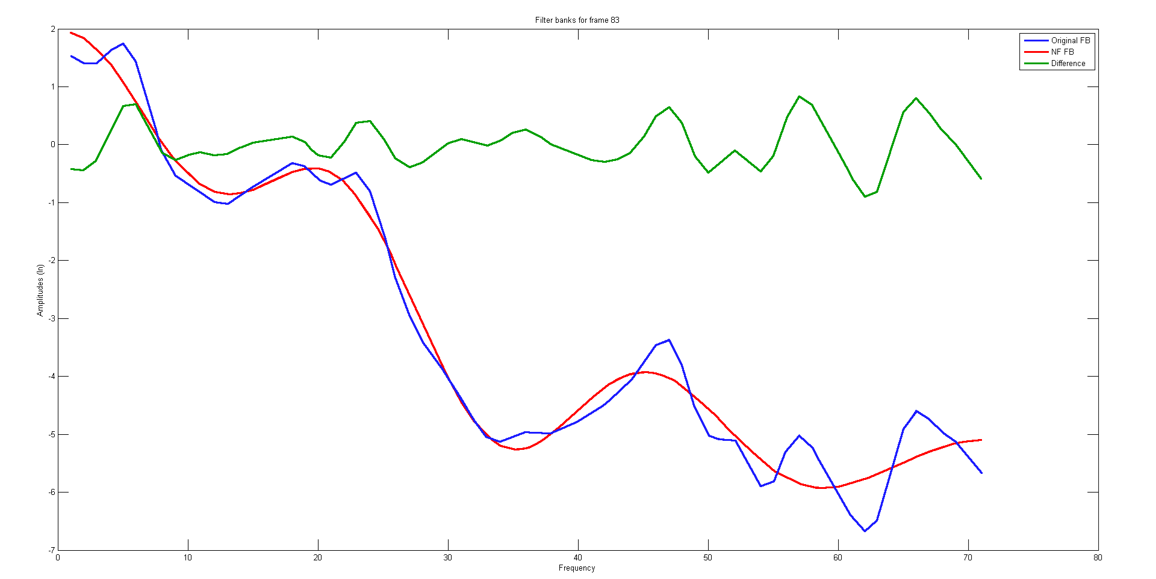
Separate modelling of spectral details
Reasons for smoothing:
Averaging similar phone realizations
NNs are designed to generalize. Fine details are treated as noise.
Solution:
Train spectral details separately from smooth spectrum
Use smooth spectrum as input for training fine details
Additional input could be linguistic features

Slide 11
Separate modelling of spectral details
Vocoder
Smooth sectrum
Spectral details
Spectral details prediction (NNa2)
Smooth sectrum
Frame-level linguistic features
Smooth spectrum prediction (NNa1)
Frame-level linguistic features
State durations
Phoneme/state duration prediction (NNd)
Text analysis
Phoneme-level linguistic features

Slide 12
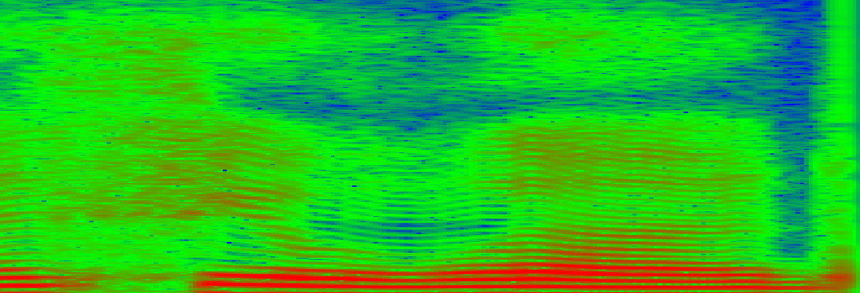
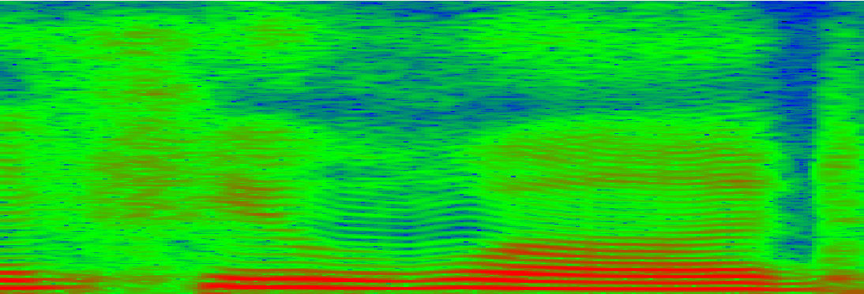
Comparison
Baseline
With spectral details

Slide 13
Contents
Text-to-Speech development in SMI:
HMM-TTS
Hybrid TTS
Neural networks based TTS
Improvements to TTS:
Separate modelling of spectral details
Voice conversion:
Simple approach

Slide 14
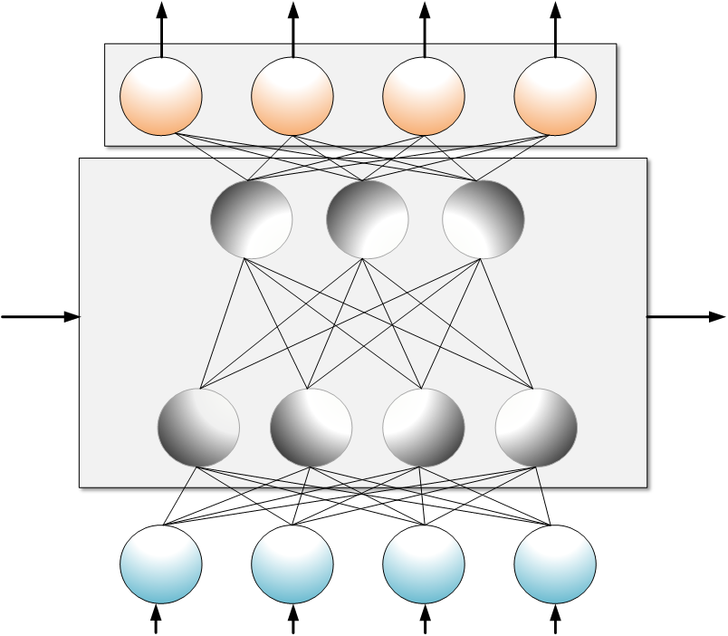
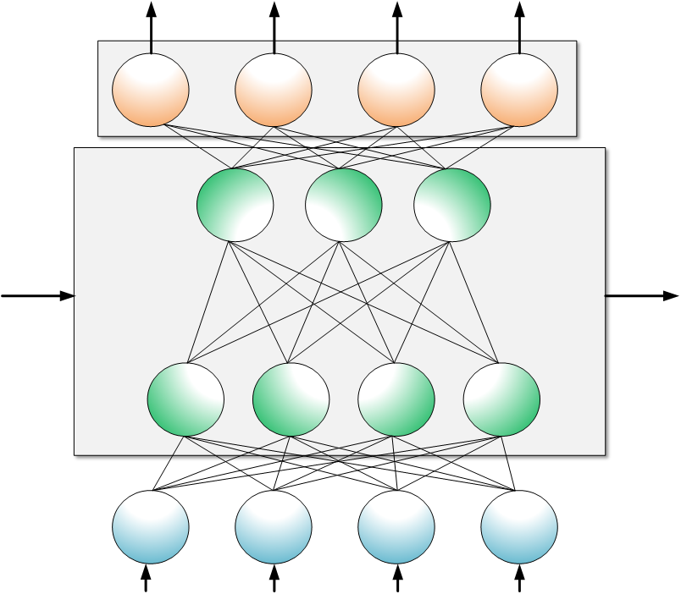
Voice conversion
Steps:
Train NN on 4+ hours of speech
Record and annotate ~10min of new speaker
Continue training NN on those new samples
Problems:
Overfitting
Inability to generalize
Alignment
Less articulated training utterances
Prosodic and phonetic coverage
4h of talent voice
10min of new speaker
synthesis with new voice

Slide 15
Comparison
Original 4h TTS 10min VC
Trevor
President 1
President 2
Not president 3

Slide 16
Thank you!

